Slide 1
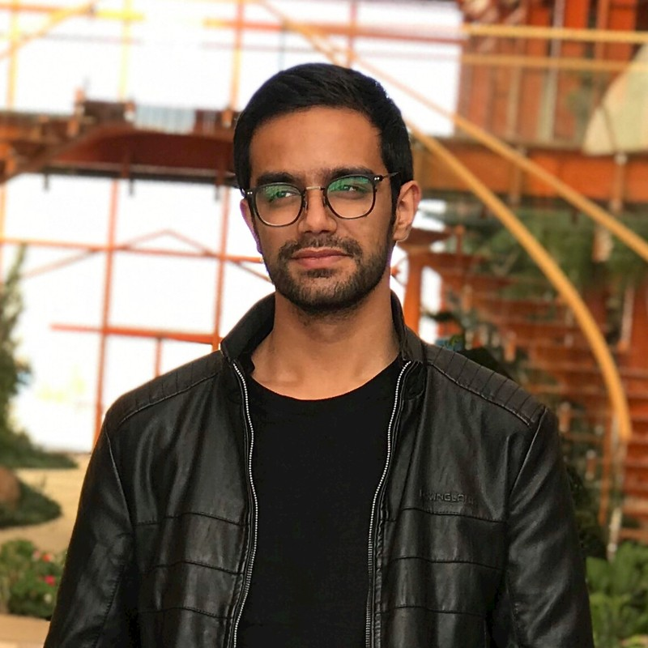
Farzad Azizi Zade
Mini SLAM Project

Slide 2
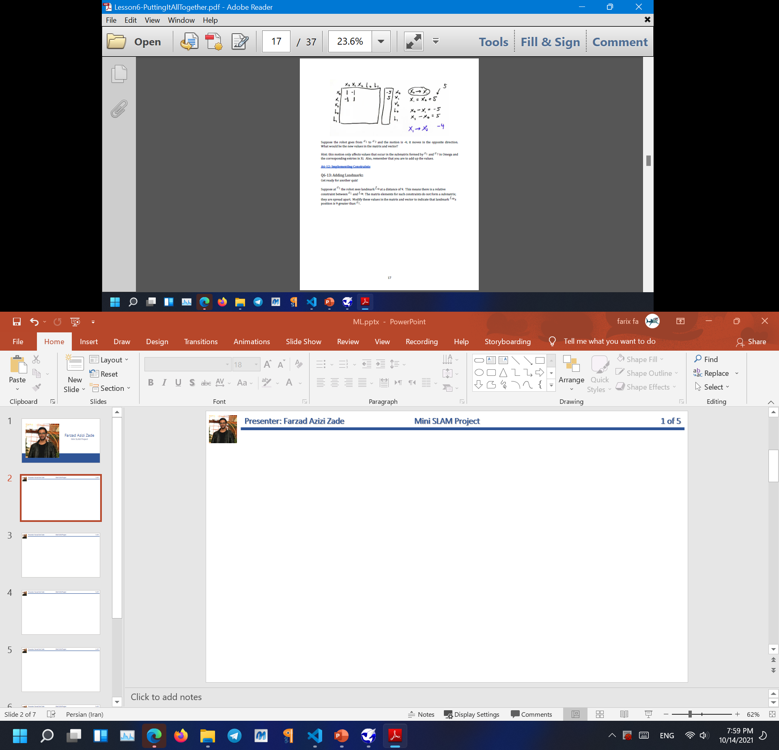
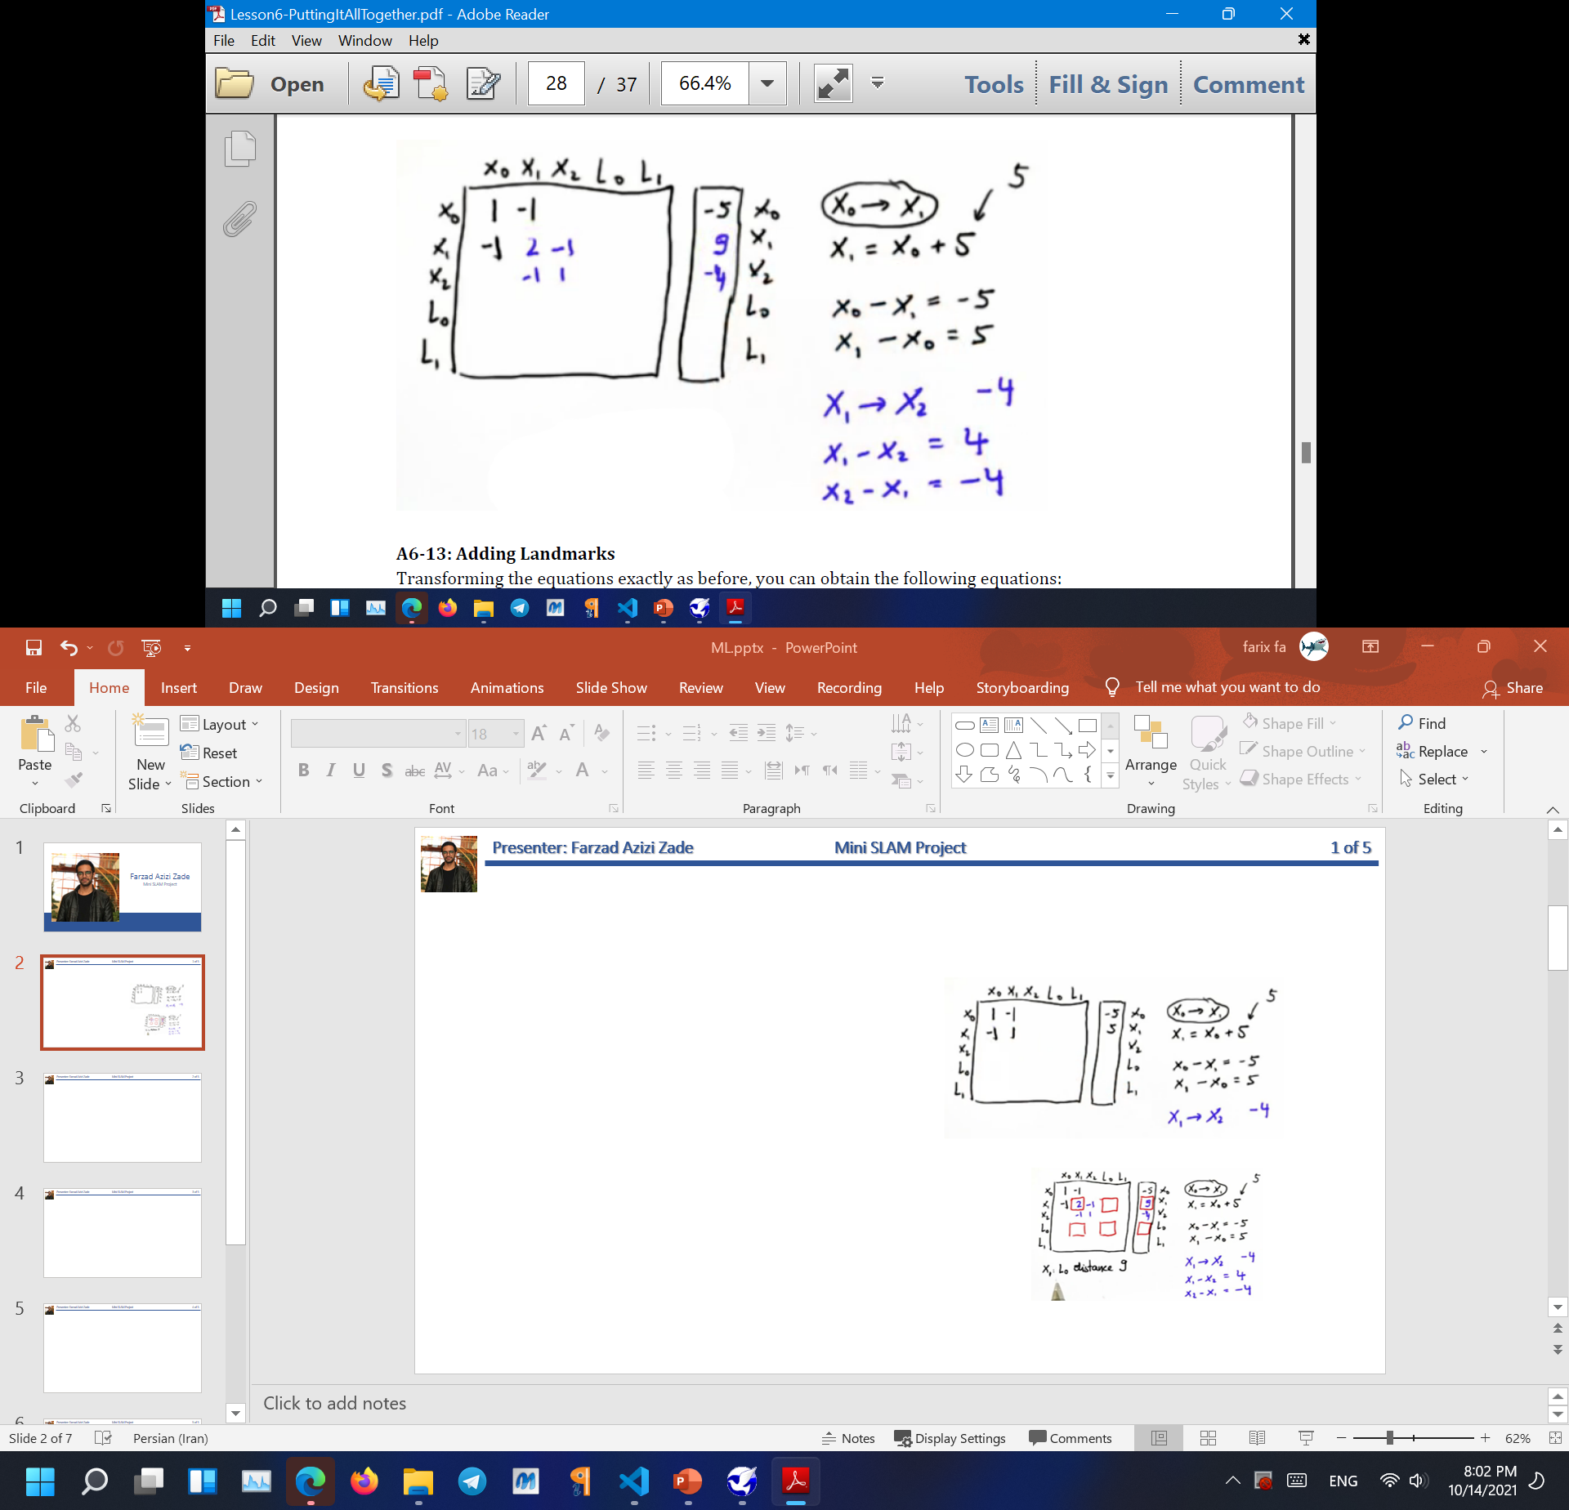
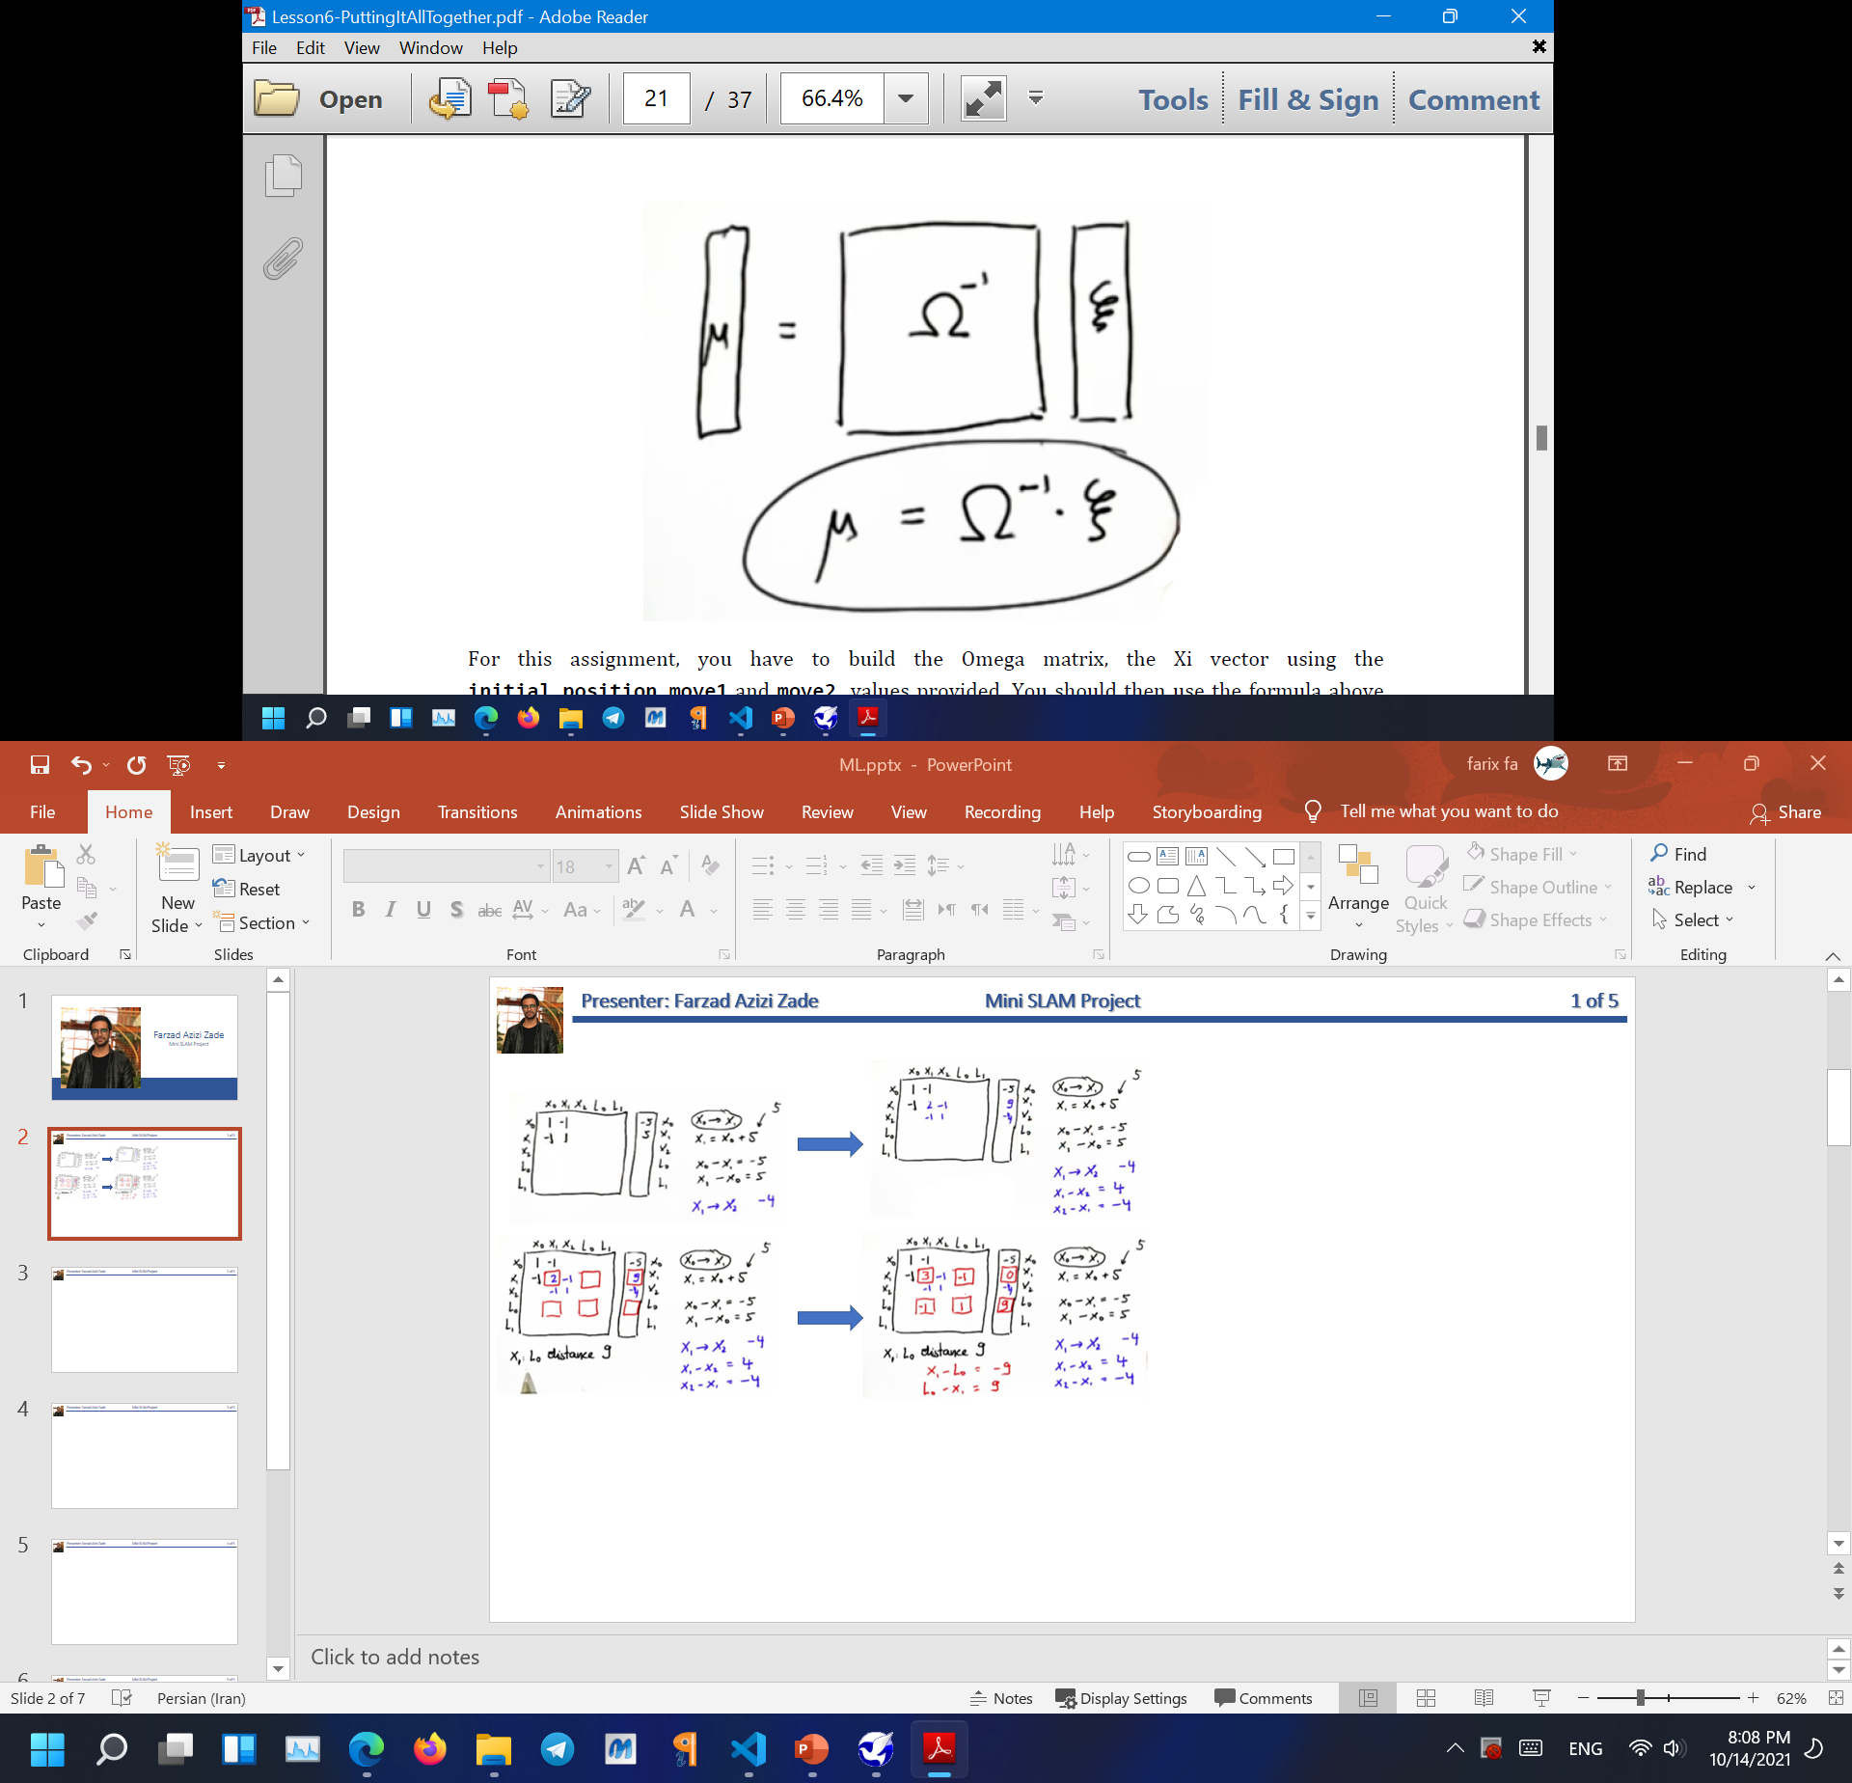
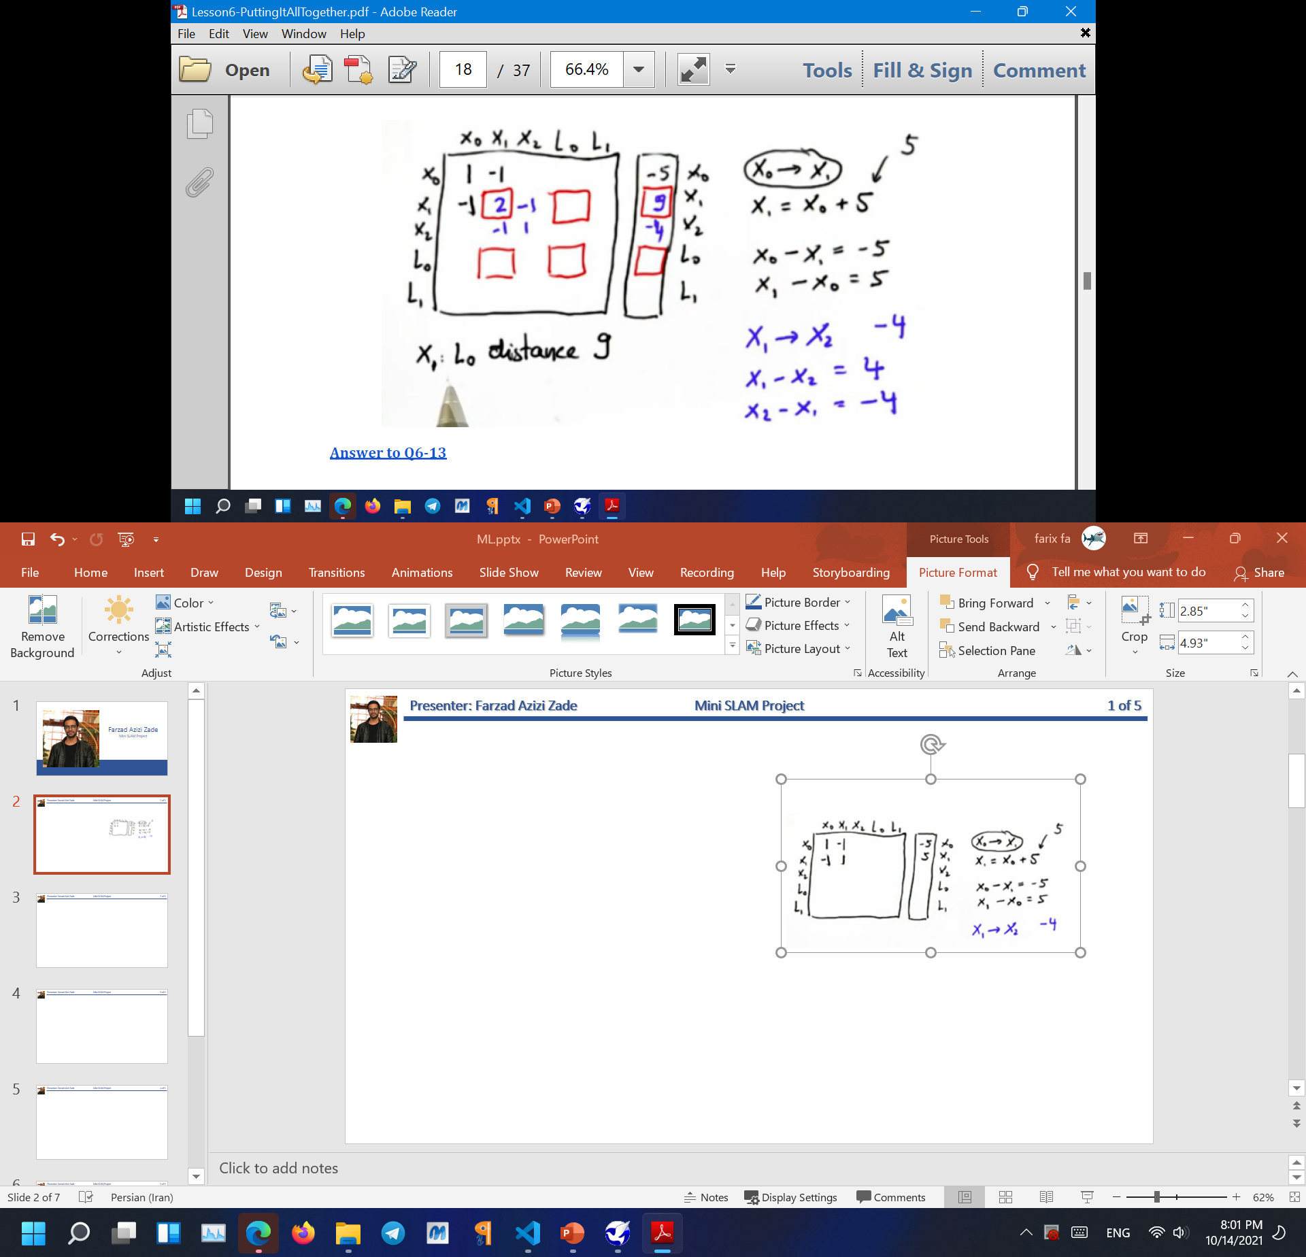
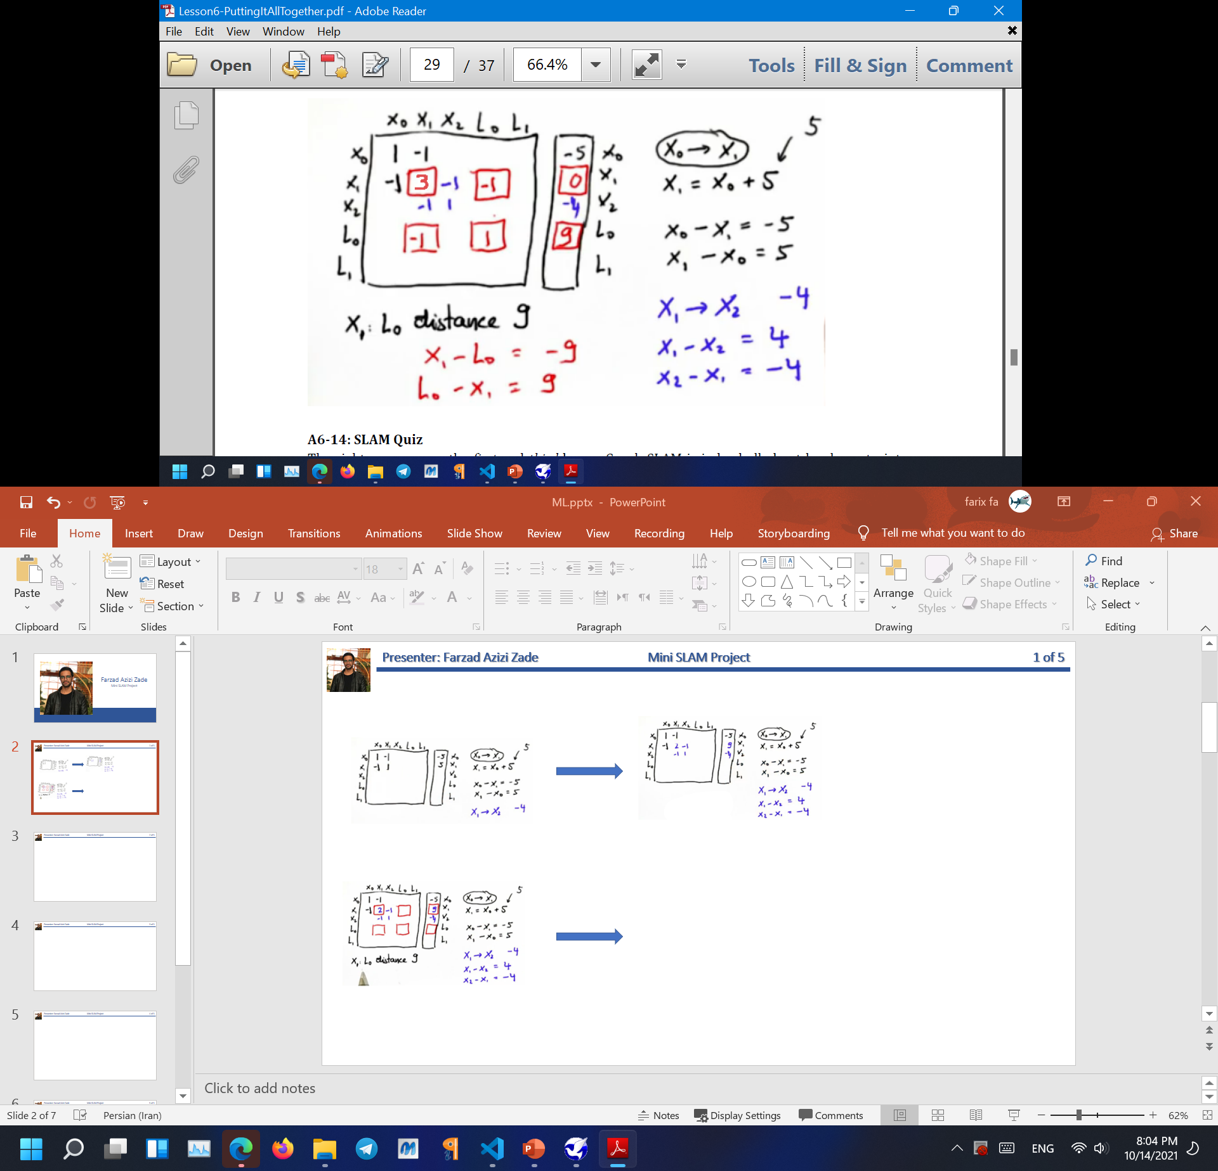
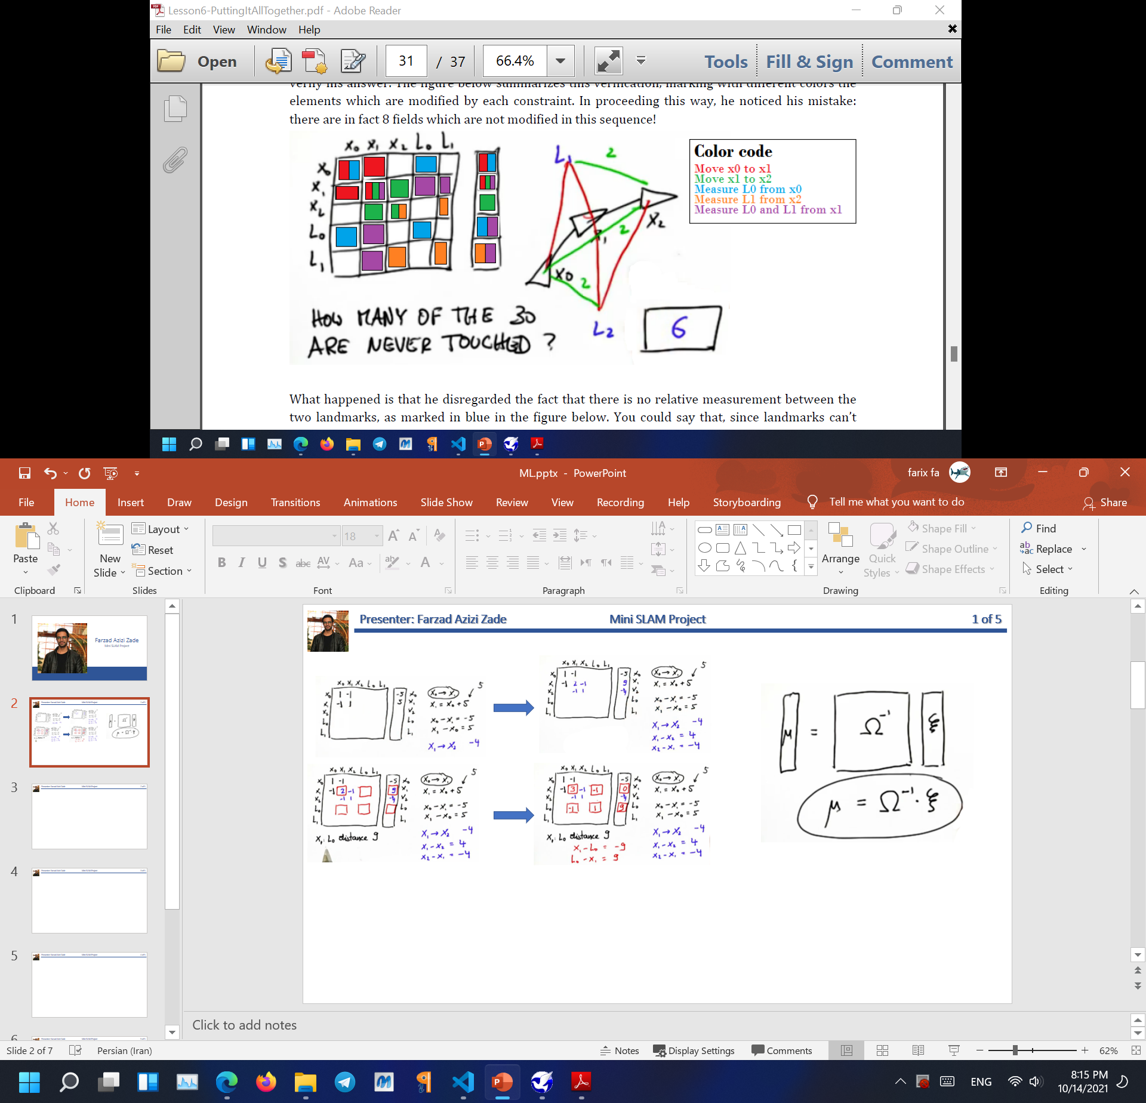
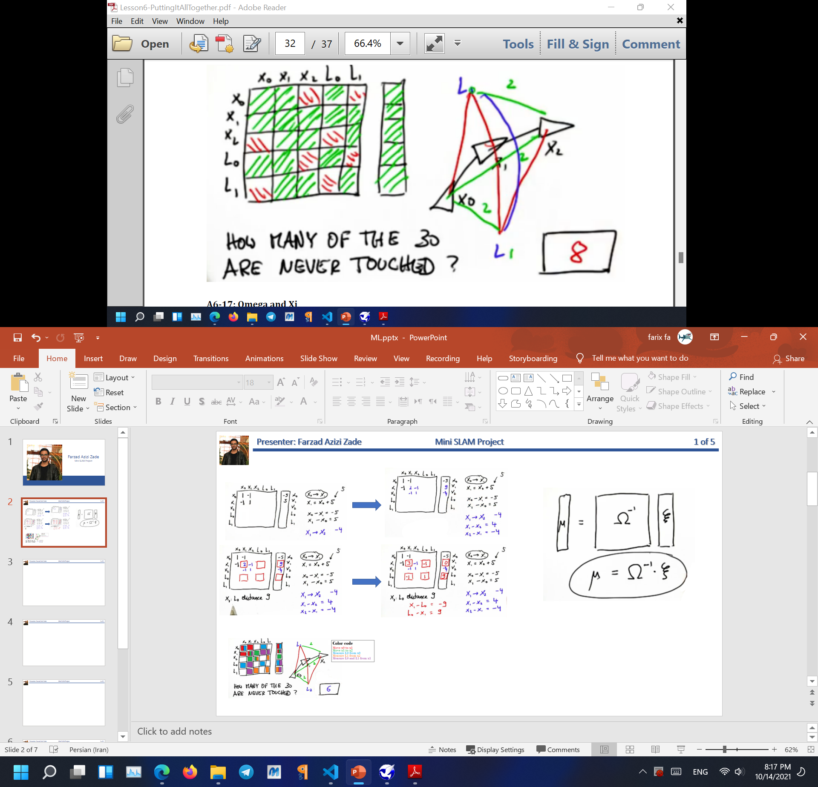
Presenter: Farzad Azizi Zade
Localization and Mapping
1 of 5
How to find 8 unknowns?
Answer:
MU:
contain the estimated robot poses (this is the localization part of SLAM) and the estimated location of the landmarks (which is the mapping).

Slide 3
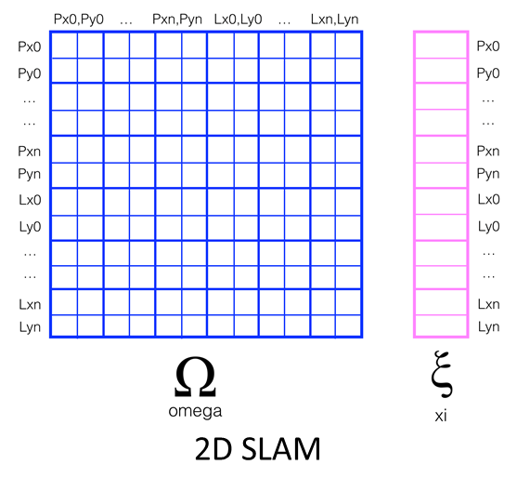
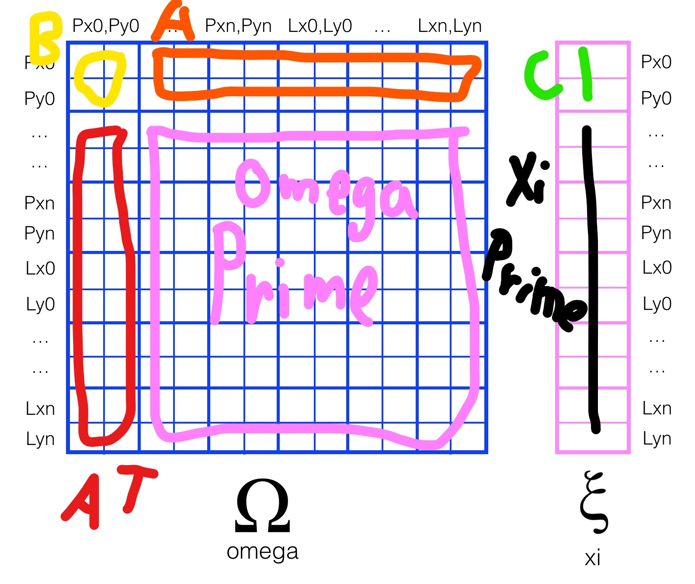
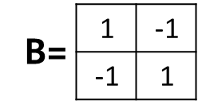
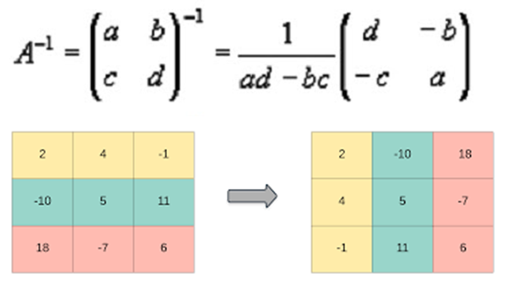
Presenter: Farzad Azizi Zade
Incremental Omega Updating
2 of 5
That’s why we need to dimx+=1
dimy+=1 when we move or have a new landmark
Each step the pink area will be updated
Omega = Omega_Prime - A^T * B^-1 * A
Xi = Xi_Prime - A^T * B^-1 * C

Slide 4
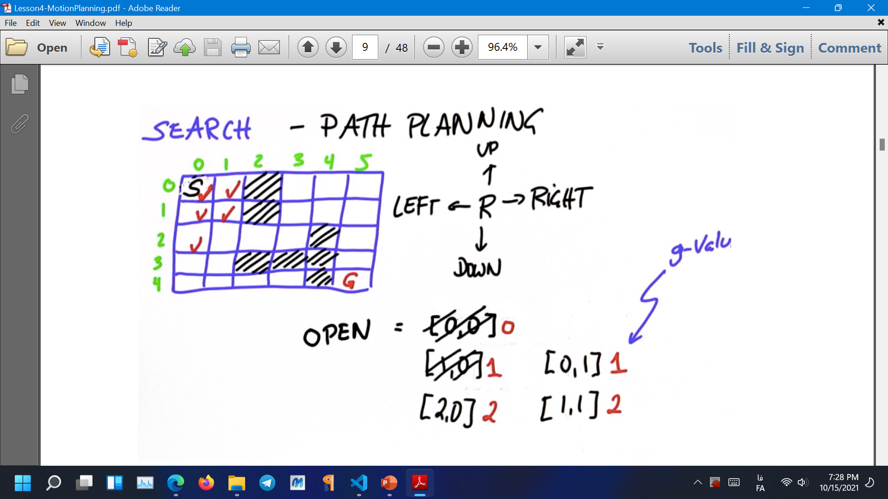
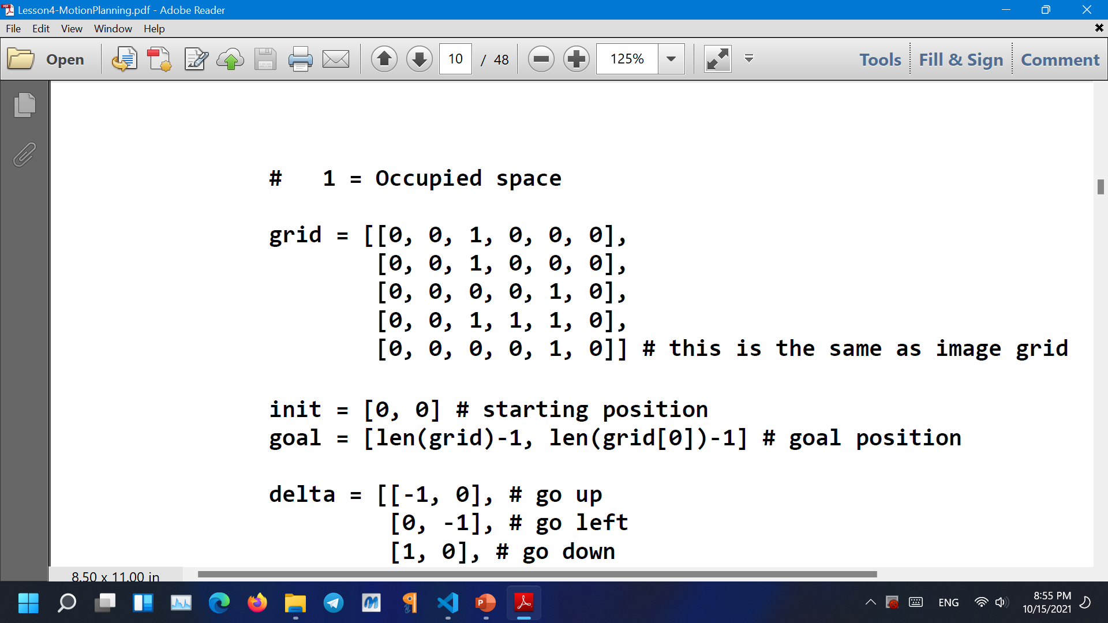
Presenter: Farzad Azizi Zade
Motion Planning
3 of 5

Slide 5
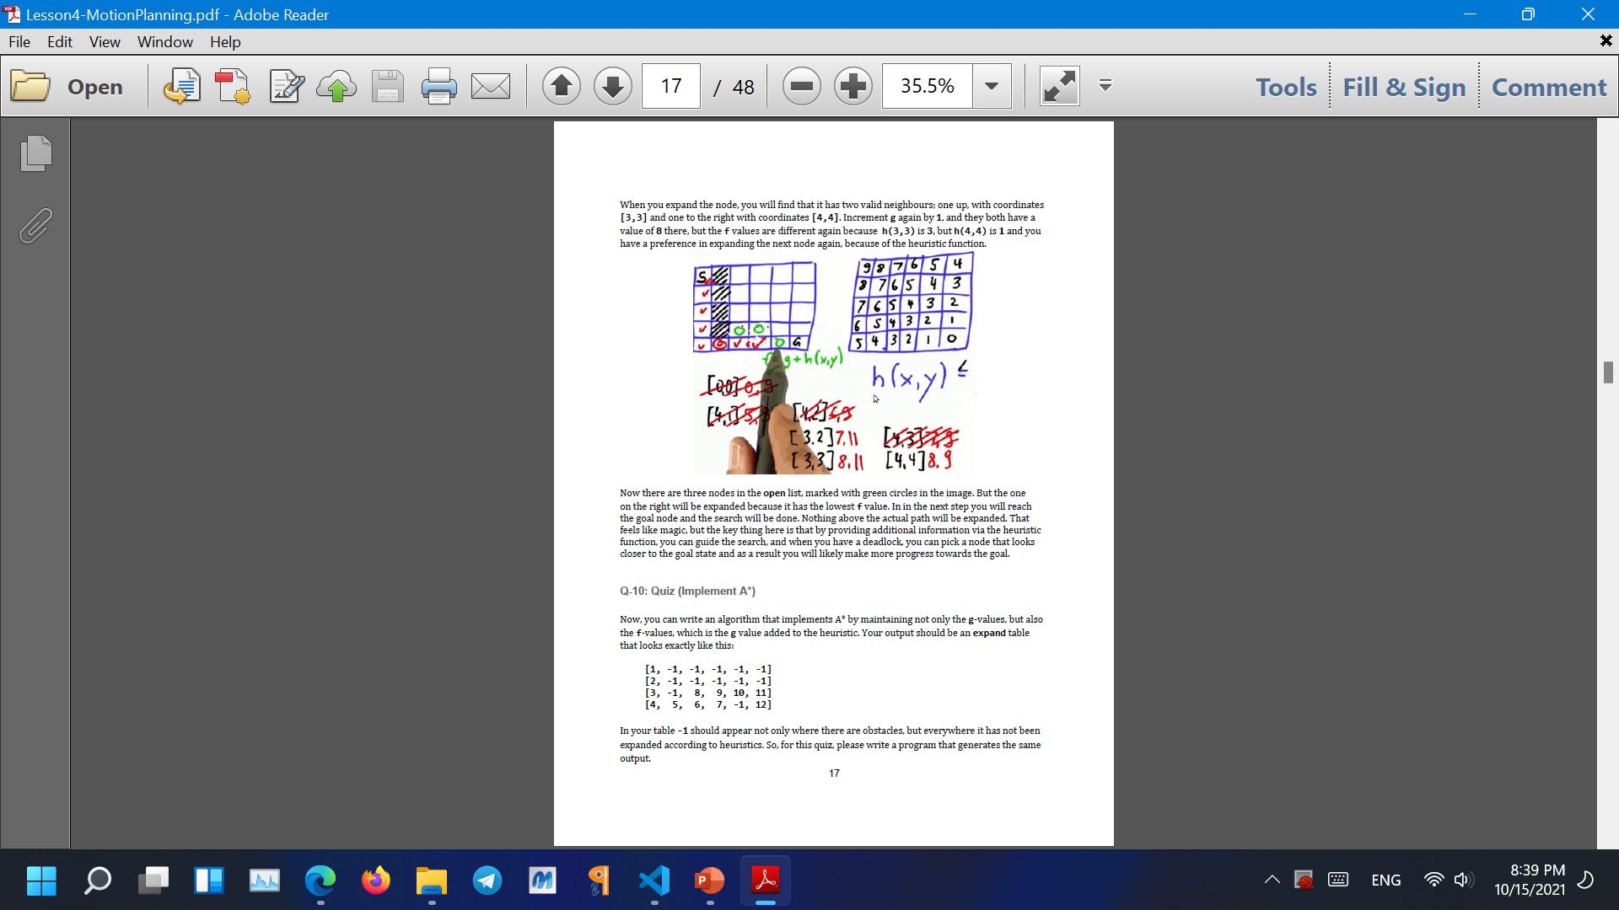
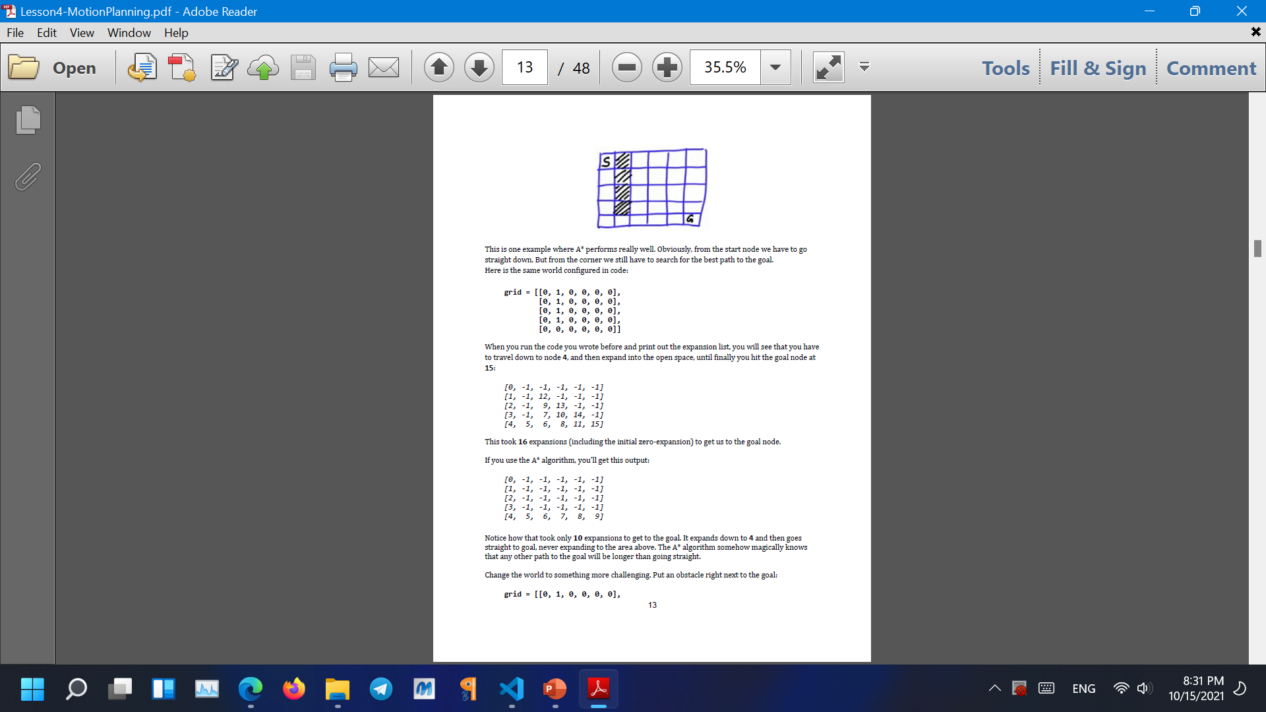
Presenter: Farzad Azizi Zade
Moving Commands
4 of 5

Slide 6
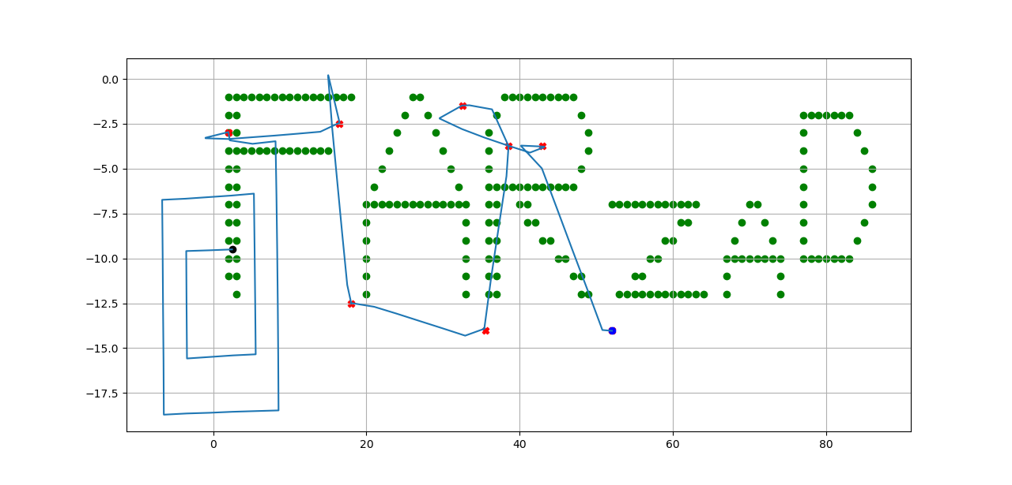
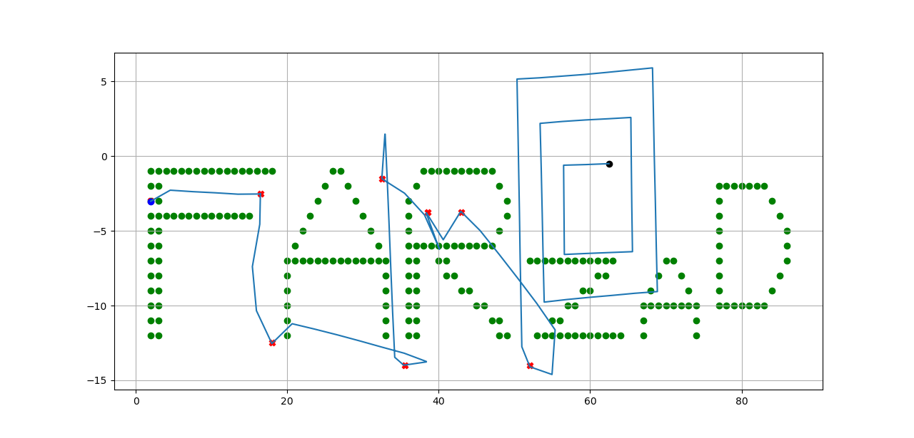
Presenter: Farzad Azizi Zade
Results
5 of 5
part A score: 100.00
part B score: 88.89
score: 92.56
The Best Score is :

Slide 7
THE END
Thanks for your Time and Consideration
Farzad Azizi Zade
Mini SLAM Project
Main Resource
Artificial Intelligence for Robotics | Udacity

